Slide 1
Objectives
In this session, you will learn to:
  Use functions to customize the result set

Slide 2

Using Functions to Customize the Result Set
What is customization?

Slide 3

Using Functions to Customize the Result Set (Contd.)
Customization includes changing the format of the string or date values or performing calculations on the numeric values in the result set.
Notes:
Explain customization with the help of examples. The date in the database is stored in the mm\dd\yy format. If you want to display only the month of the date values stored in the database, you need to customize the date values. Similarly, to display total cost of the order, you need to perform calculation on the rate and quantity purchased for the product.

Slide 4
Using Functions to Customize the Result Set (Contd.)
SQL Server 2005 provides the following in-built functions to customize the result set:
  String functions
  Date functions
  Mathematical functions
  Ranking functions
  System functions
Notes:
Introduce the various built-in functions used in SQL Server 2005 for customizing the result set.

Slide 5
Using String Functions
  String functions:
  Are used to manipulate the string values in the result set.
  Are used with the char and varchar data types.
  Syntax:
    SELECT function_name (parameters)
Notes:
Discuss the syntax of using string functions.

Slide 6
Using String Functions (Contd.)
  The following table lists some of the string functions provided by SQL Server 2005.
Function name | Parameters | Example | Description
char | (integer_expression) | SELECT char(65) | Returns 'A', the character equivalent of the ASCII code value
left | (character_expression, integer_expression) | SELECT left ('RICHARD',4) | Returns 'RICH', which is a part of the character string equal in size to the integer_expression characters from the left
len | (character_expression) | SELECT len ('RICHARD') | Returns 7, the number of characters in the character_expression
ltrim | (character_expression) | SELECT ltrim (' RICHARD') | Returns 'RICHARD' without leading spaces. It removes leading blanks from the character expression
reverse | (character_expression) | SELECT reverse ('ACTION') | Returns 'NOITCA', the reverse of the character_expression
Notes:
Briefly explain some of the string functions to make students understand about their usage. The slide lists only the frequently used string functions. You can also discuss other string functions given in SG.

Slide 7
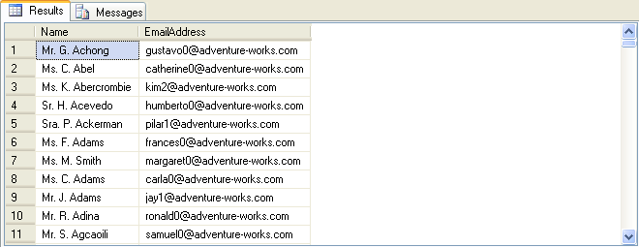
Using String Functions (Contd.)
  For example:
      SELECT Name = Title + ' ' + left(FirstName,1) + '. ' + LastName, EmailAddress FROM Person.Contact
Output
Notes:
Demonstrate the example given in the slide. You can also demonstrate the usage of the upper() function as given in an example in SG. In addition, demonstrate the additional example given in the Input doc for this session.

Slide 8
Using Date Functions
  Date functions are used to manipulate datetime values.
  The following table lists some of the date functions provided by SQL Server 2005.
Function name | Parameters | Example | Description
dateadd | (date part, number, date) | SELECT dateadd(mm, 3,’2009-01-01’) | Returns 2009-04-01, adds 3 months to the date
datename | (date part, date) | SELECT datename(month, convert(datetime,'2005-06-06')) | Returns June, date part from the listed date as a character value)
getdate | () | SELECT getdate() | Returns the current date and time
day | (date) | SELECT day('2009-01-05') | Returns 5, an integer, which represents the day
Notes:
Explain the purpose of using date functions. Then, describe some of the date functions provided by SQL Server 2005. While explaining the datename function, first describe the usage of the convert function. The slide lists only the frequently used date functions. You can also discuss other date functions given in SG.

Slide 9
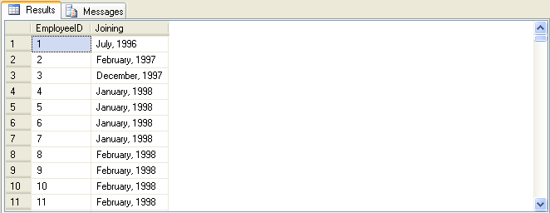
Using Date Functions (Contd.)
  The following SQL query uses datename() and datepart() functions to retrieve the month name and year from a given date:
    SELECT EmployeeID, datename(mm, hiredate)+ ', ' + convert(varchar, datepart(yyyy, hiredate)) as 'Joining' FROM HumanResources.Employee
Output
Notes:
Demonstrate the example given in the slide. You can use the following query to display the same result as given in the slide:
SELECT EmployeeID,datename(mm, hiredate)+ ', ' + datename(yyyy, hiredate)) as 'Joining'
FROM HumanResources.Employee
Explain that datename function returns value in the form of characters and datepart returns value in the form of integer. However, the concatenation operator (+) concatenates character values only. Therefore, if you use datepart function, you need to convert the value to character format before concatenation. However, if you use datename function, you do not need to use the convert function.
Demonstrate the additional example given in the Input doc for this session.
You can also demonstrate other examples given under the topic “Using Date Functions” in SG.

Slide 10
Using Mathematical Functions
Mathematical functions are used to manipulate the numeric values in a result set.
The following table lists some of the mathematical functions provided by SQL Server 2005.
Function name | Parameters | Example | Description
ceiling | (numeric_expression) | SELECT ceiling(14.45) | Returns 15, the smallest integer greater than or equal to the specified value
exp | (float_expression) | SELECT exp(4.5) | Returns 90.0171313005218, the exponential value of the specified value
floor | (numeric_expression) | SELECT floor(14.45) | Returns14, the largest integer less than or equal to the specified value
power | (numeric_expression, y) | SELECT power(4,3) | Returns 64, which is 4 to the value of 3
round | (numeric_expression, length) | SELECT round(15.789, 2) | Returns 15.790, a numeric expression rounded off to the length specified as an integer expression
Notes:
Explain the purpose of using mathematical functions. Then, describe some of the math functions provided by SQL Server 2005. The slide lists only the frequently used math functions. You can also discuss other math functions given in SG.

Slide 11
Using Mathematical Functions (Contd.)
  The following table lists the usage of the round() function provided by SQL Server 2005.
Function | Output
round (1234.567,2) | 1234.570
round (1234.567,1) | 1234.600
round (1234.567,0) | 1235.000
round (1234.567,-1) | 1230.000
round (1234.567,-2) | 1200.000
round (1234.567,-3) | 1000.000
Notes:
Explain the usage of the round() function as provided in the table given in the slide.

Slide 12
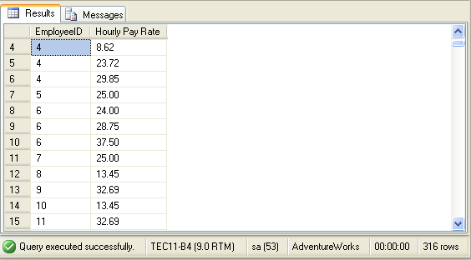
Using Mathematical Functions (Contd.)
  The following SQL query retrieves the EmployeeID and Rate for a specified employee id from the EmployeePayHistory table:
    SELECT EmployeeID, 'Hourly Pay Rate' = round(Rate,2)
    FROM HumanResources.EmployeePayHistory
Output
Notes:
Demonstrate the example given in the slide.

Slide 13
Just a minute
Identify the utility of the datepart function.
Solution:
  The datepart function is used to extract different parts of a date value.
Notes:
Reiterate the concepts taught earlier by asking the given question.

Slide 14
Just a minute
The management of AdventureWorks wants to increase the shift time from 8 hours to 10 hours. Calculate the end time of the shifts based on their start time.
Solution:
  SELECT ShiftID, StartTime, 'EndTime' = dateadd (hh, 10, StartTime) FROM HumanResources.Shift
Notes:
Reiterate the concepts taught earlier by asking the given question.

Slide 15
Summary
In this session, you learned that:
  The string functions are used to format data in the result set.
  The date functions are used to manipulate date values.
  The mathematical functions are used to perform numerical operations.
Notes:
You can summarize the session by running through the summary given in SG.
In addition, you can also ask the students to summarize what they have learnt in this session.

